Slide 1

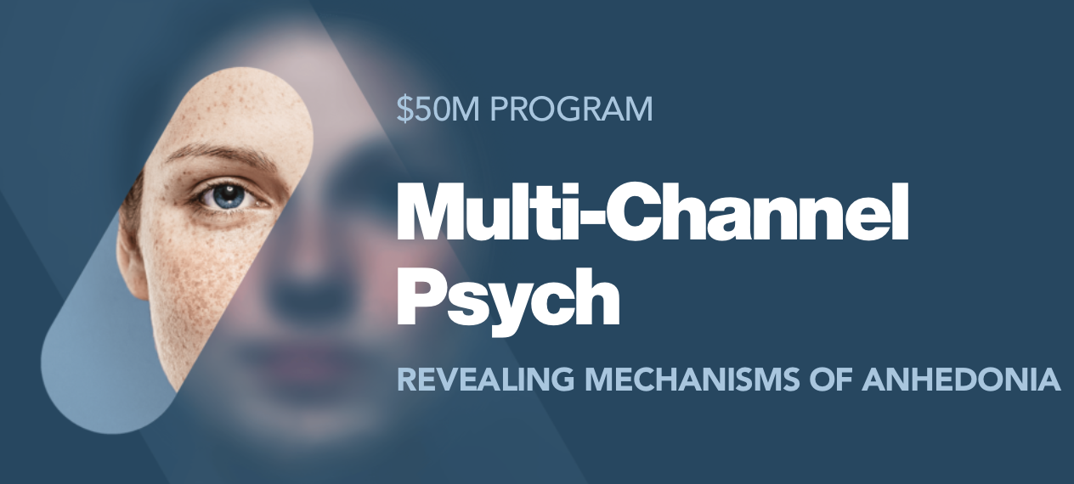

Mapping NeuroGraph to CWL Design Studio for fMRI Modeling
Anwar Said, Yogesh Barve, Tamas Kecskes, Xenofon Koutsoukos, and Janos Sztipanovits
Institute for Software Integrated Systems, Vanderbilt University, TN

Slide 2
Agenda
Introduction to NeuroGraph package
CWL Design Studio
Training Pipeline
CWL components
Testing Workflows
CWL Walkthrough

Slide 3
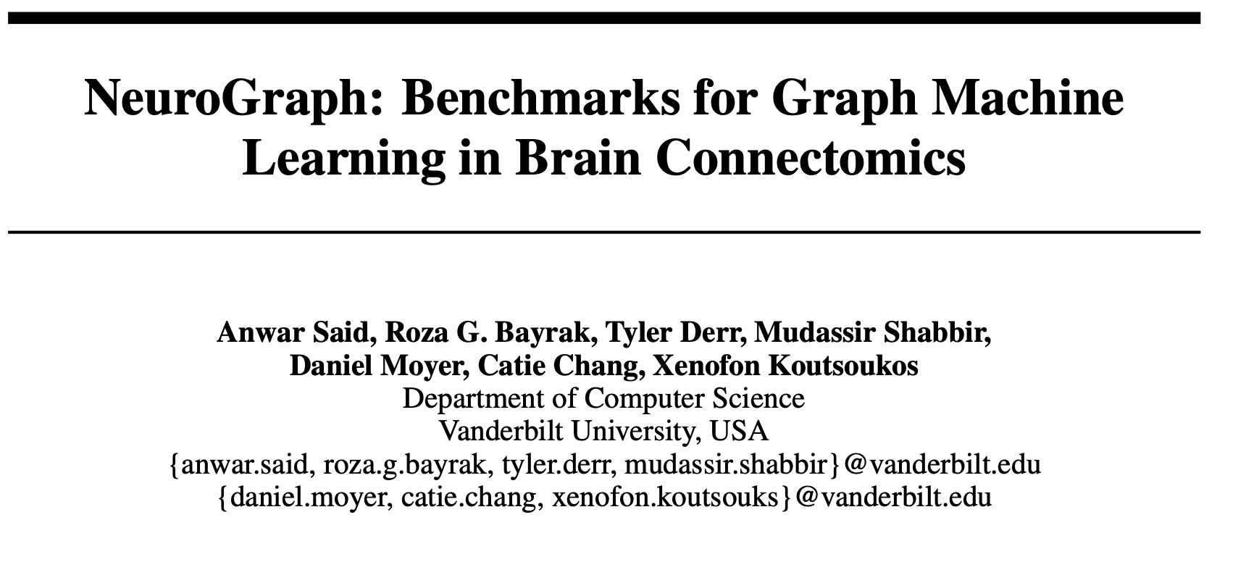
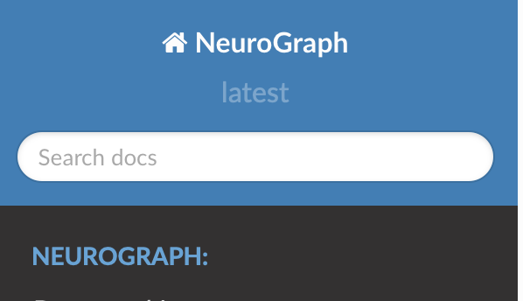
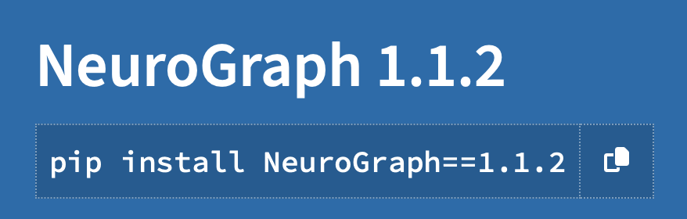

Slide 4
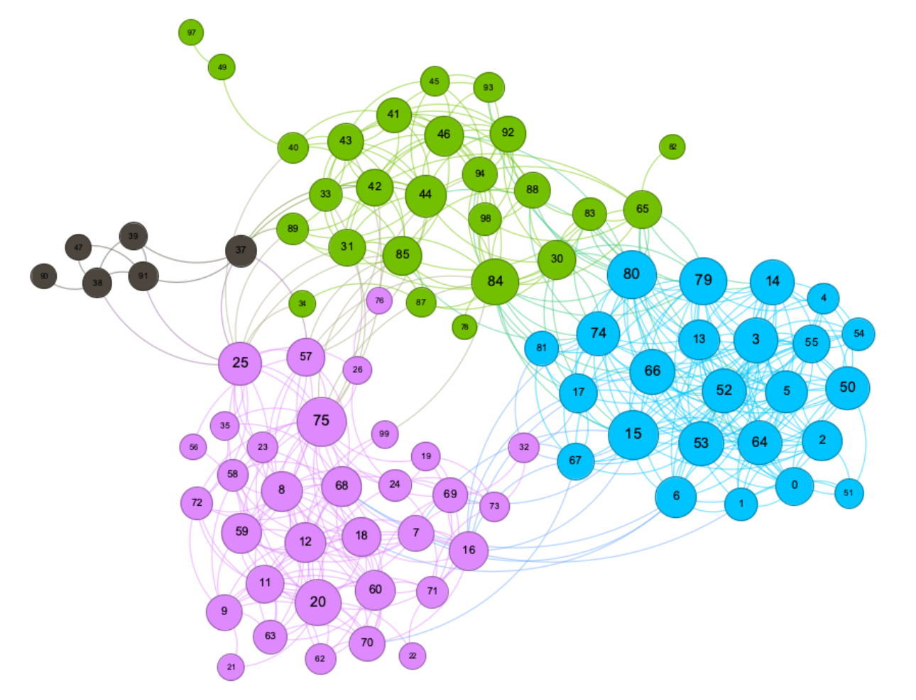
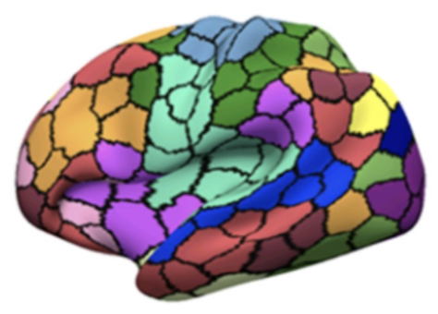
Motivation
Graph machine learning is a powerful paradigm for learning from graph-structured data
Utilizes relationships within the data compared to just the data alone to make better predictions
Applications:
Recommendation
Forecasting
Neuroimaging, and a lot more
Provides a natural way to exchange messages between highly correlational regions of interests in the brain

Slide 5
Challenges
Complex preprocessing pipelines
Requires domain knowledge
Huge parameter search space
Parcellation methods
Number of ROIs
Thresholding
Different types of graph data modalities, etc.
No available easy-to-use programming tools
NeuroGraph:
Provides tools for preprocessing fMRI data
Constructing graph-based datasets and models
Provides graph-based Neuroimaging benchmarks with a set of prediction tasks

Slide 6
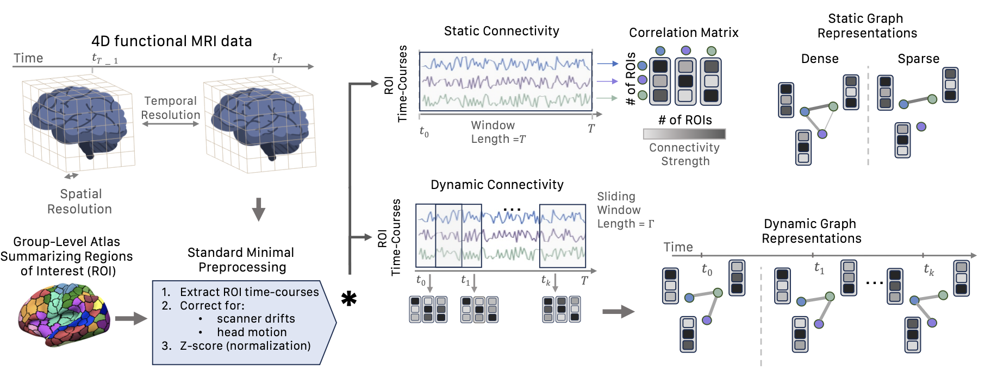
NeuroGraph: Preprocessing Pipeline

Slide 7
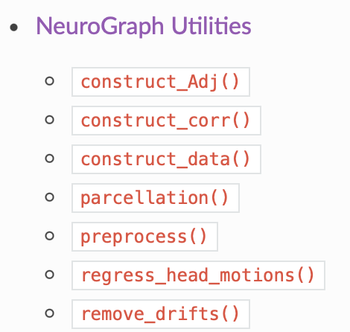
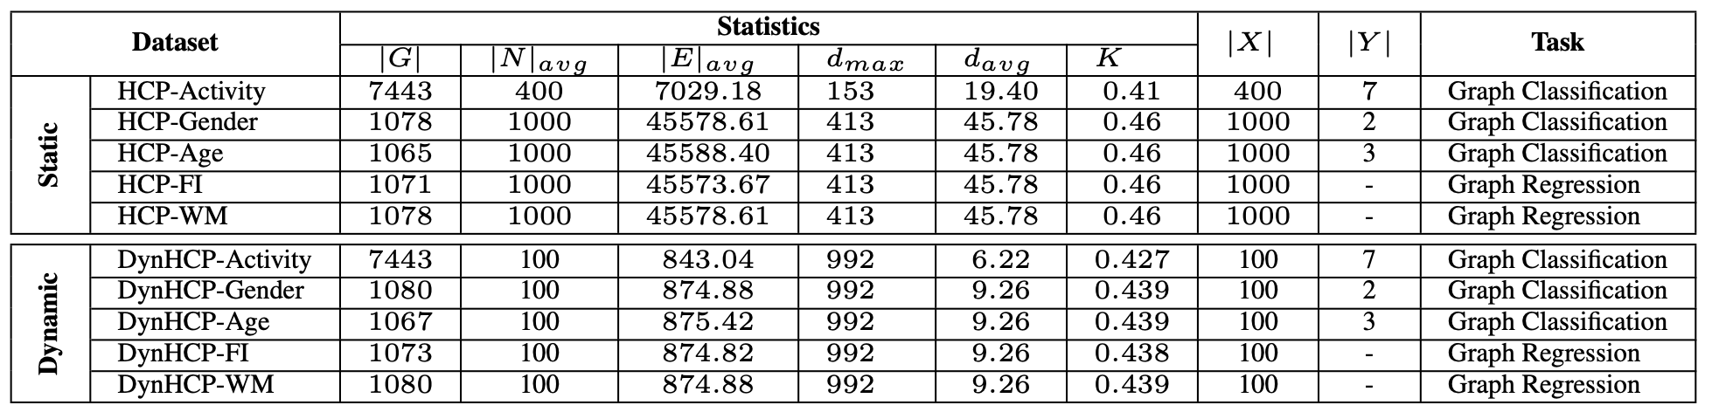
Tools and Benchmarks
Parcellation
Remove drifts
Remove head motions
Correlation matrices
Create graphs
Classes for constructing graph-based brain datasets

Slide 8
Mapping NeuroGraph to CWL
Describe and execute models in a standardized and transparent manner
Preprocess data with a single command
Easy to extend or update according to specific requirements
Easily train and save models
Perform inference with a single command
Achieve reproducible results through FAIR methods
Interoperability: compatible across multiple flatforms

Slide 9

CWL Workflows
Three step solution
fMRI preprocessing workflow
Train model
Test model

Slide 10
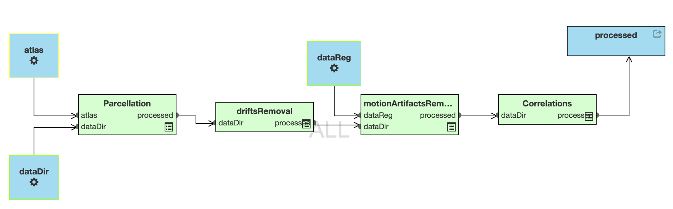
Preprocessing Workflow

Slide 11
fMRI preprocessing Steps
Parcellation
Divide the brain into distinct regions based on anatomical or functional characteristics
Provides a foundation for studying connectivity patterns
Remove Drifts
Removing low-frequency trends from the image
Detrending with quadratic polynomial function is used
Remove motion artifact
Regress out six rigid-body head motions parameters along with their derivatives
Compute correlation matrix

Slide 12
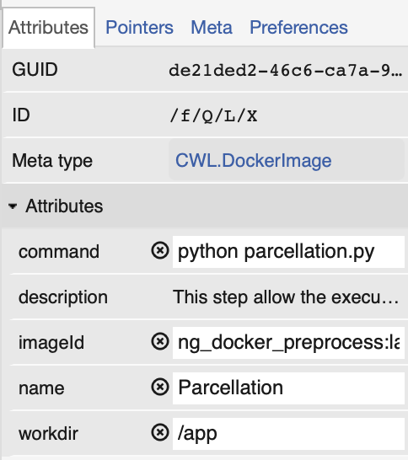
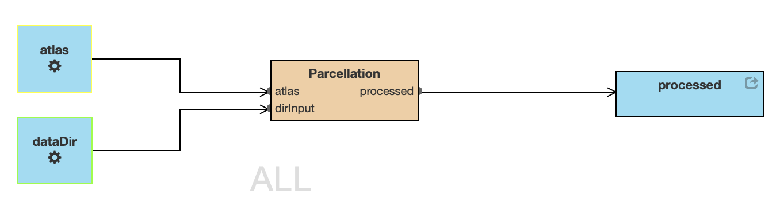
Parcellation

Slide 13
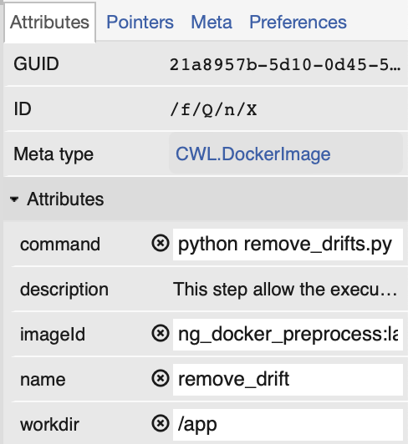
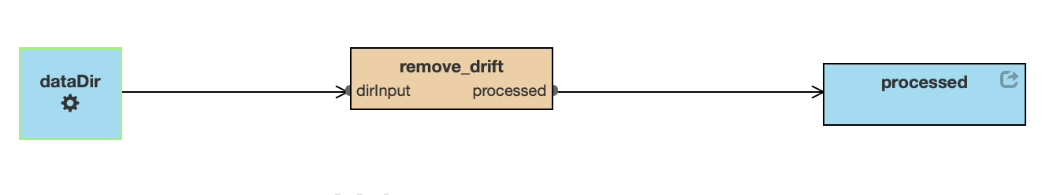
Remove Drift

Slide 14
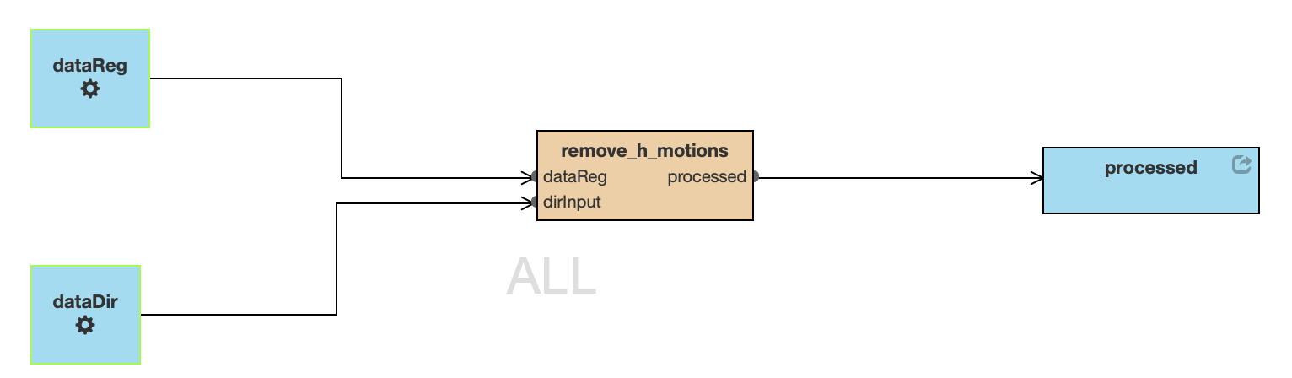
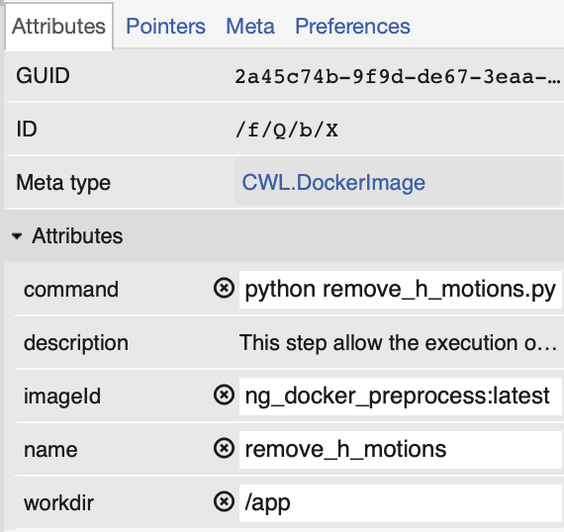
Remove Motion Artifacts

Slide 15
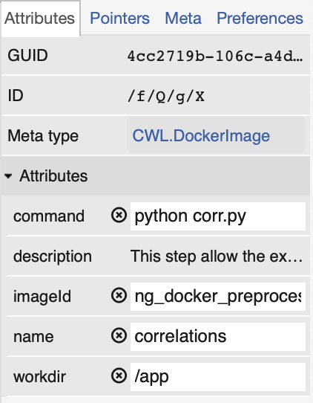
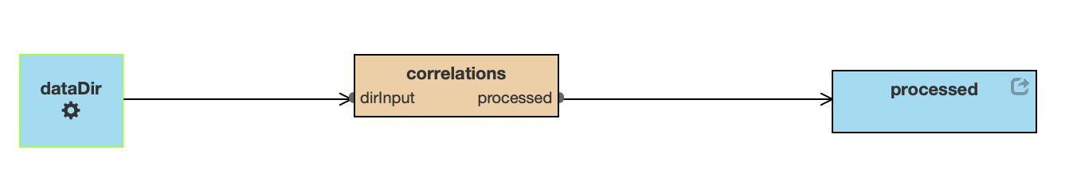
Constructing Correlations

Slide 16
Running The Workflow
cwltool --no-match-user --no-read-only --tmpdir $PWD --preserve-environment LEAP_CLI_DIR fMRI_preprocess.cwl.json --dataReg data/raw --dataDir data/raw --atlas data/atlas.nii.gz

Slide 17
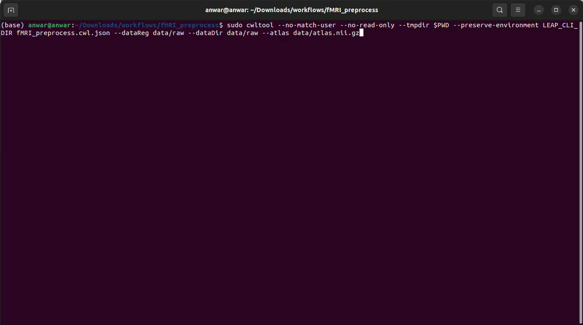
Demo

Slide 18
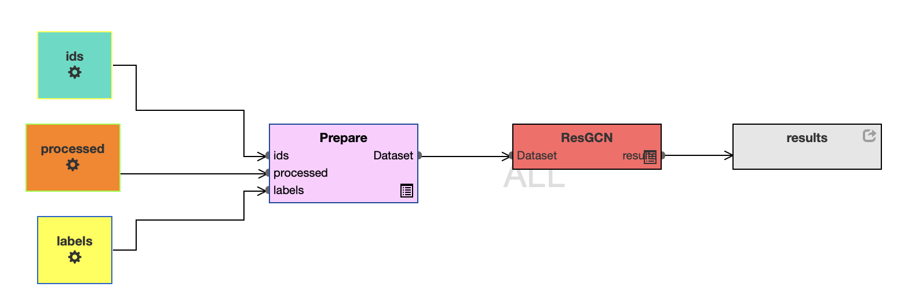
Training Graph Neural Networks

Slide 19
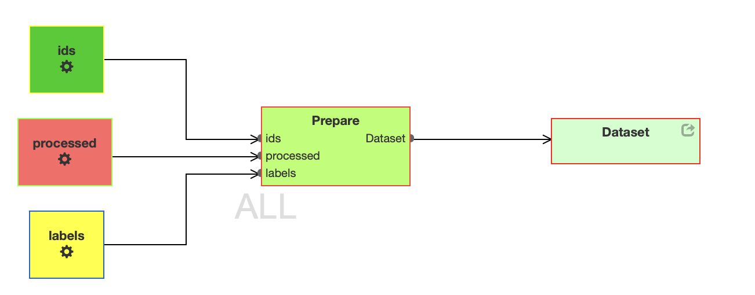
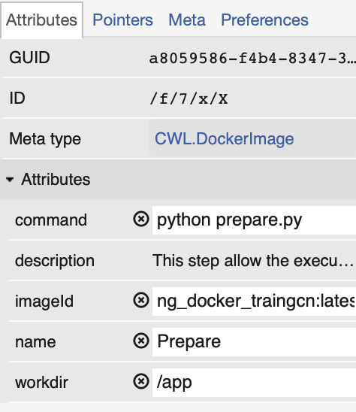
Prepare Workflow

Slide 20
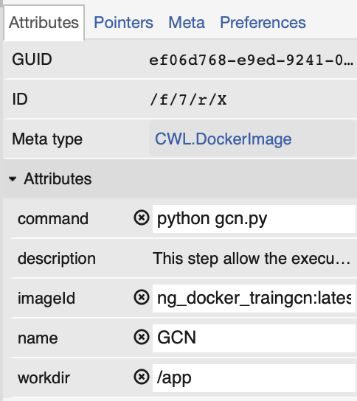
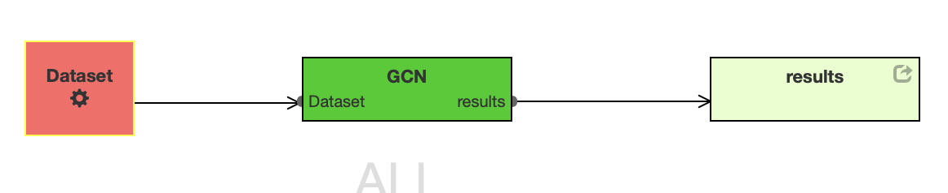
Train Workflow

Slide 21
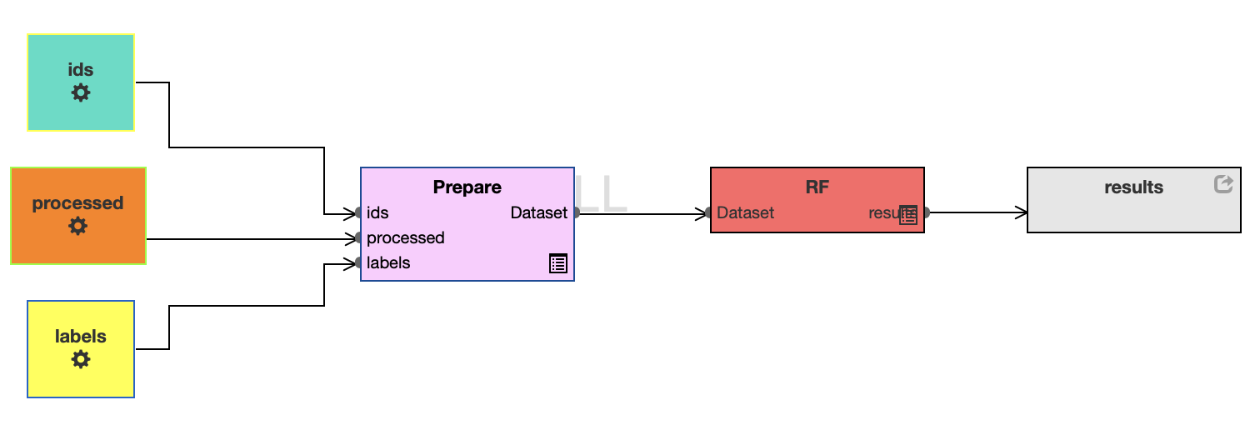
Train Random Forest

Slide 22
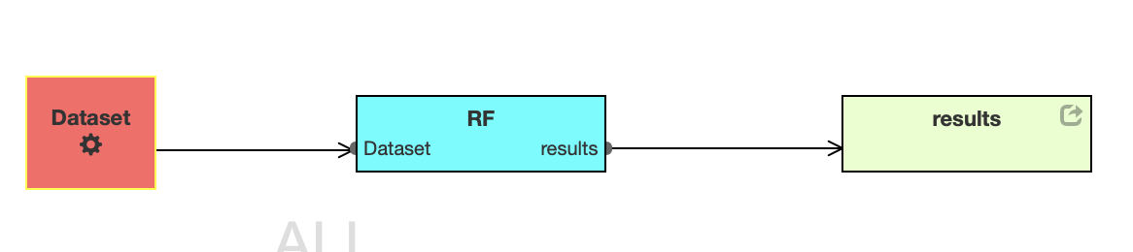
Train Workflow

Slide 23
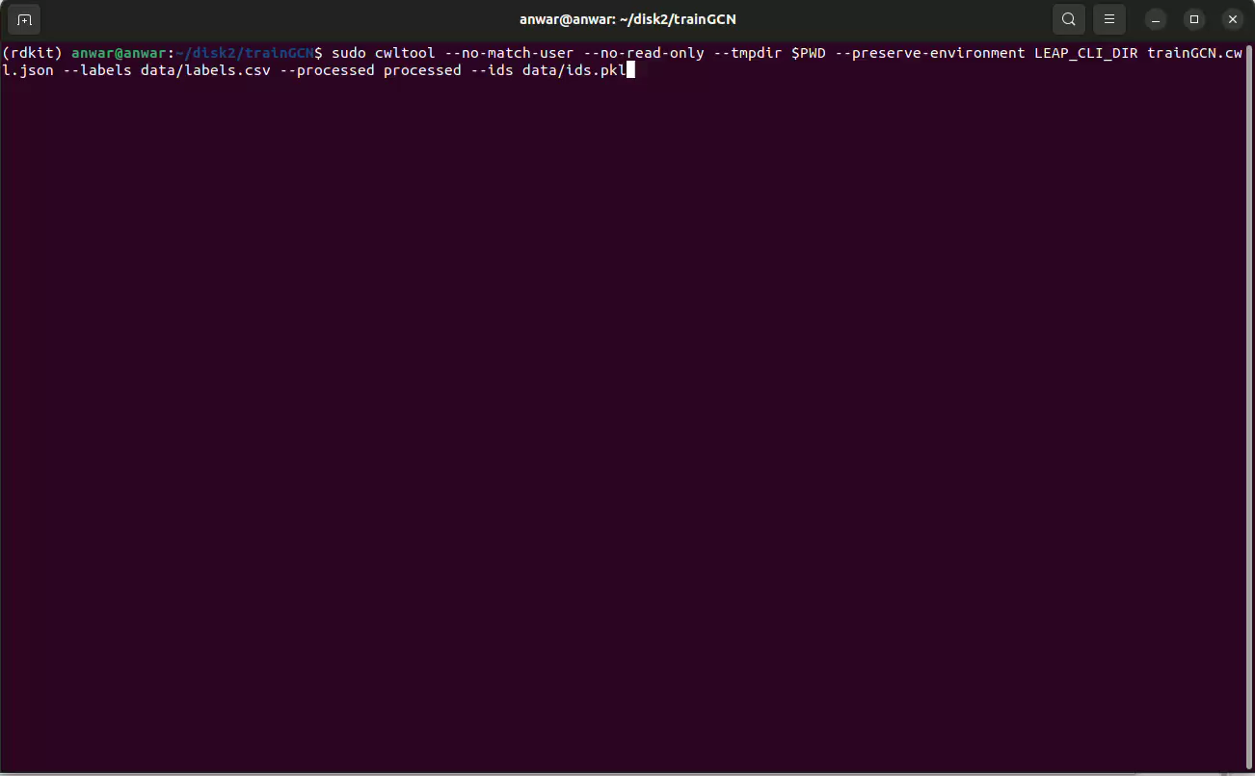
Demo

Slide 24
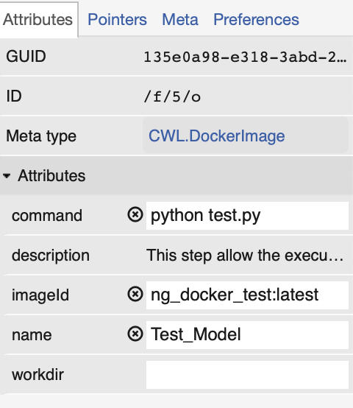
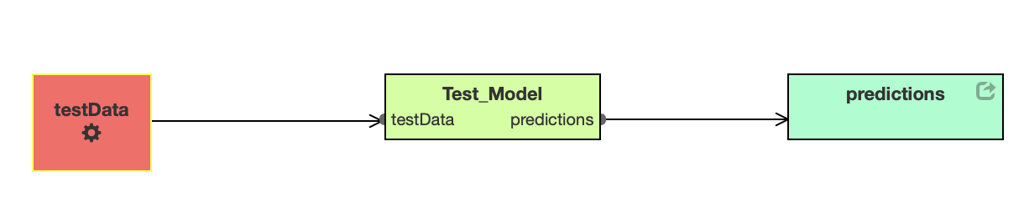
Test Model

Slide 25
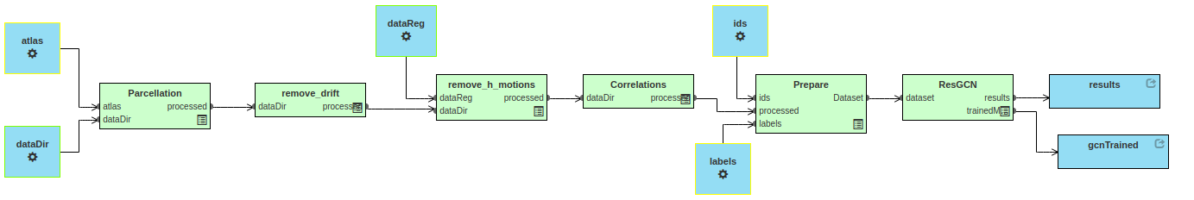
End-to-End Workflow

Slide 26
Resources
GitHub: https://github.com/Anwar-Said/NeuroGraphCWL
Documentation: https://neurograph.readthedocs.io/en/latest/
Paper: https://arxiv.org/abs/2306.06202

